Slide 1
RHTA
Rocky Hill Teachers Association
Good Morning!
Welcome Back!
2015-2016
Lori Cebelius & Michelle Bartha

Slide 2
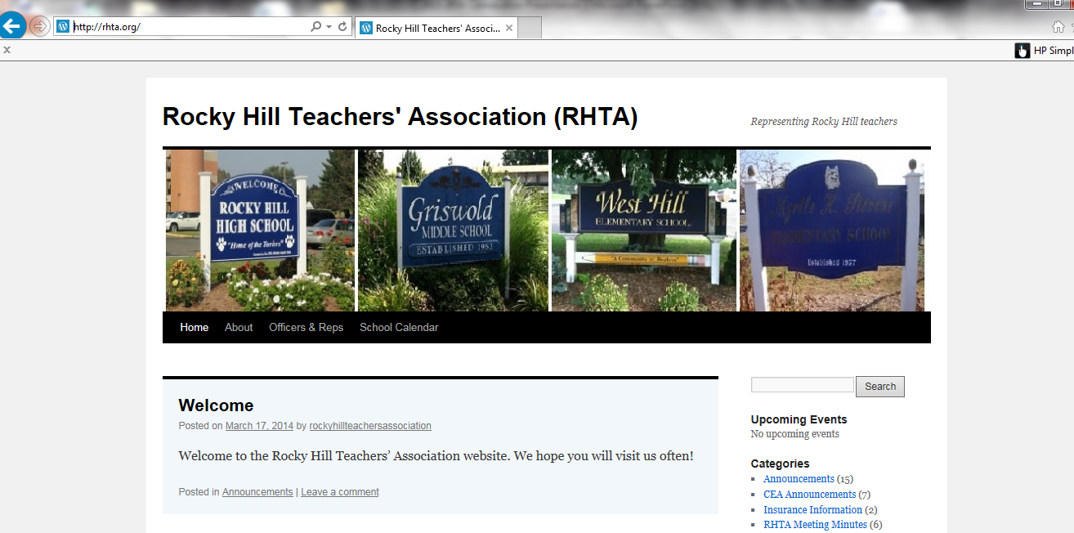
We have our own
RHTA Website
www.rhta.org
This presentation will be uploaded for your convenience

Slide 3

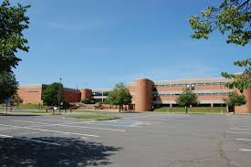
RHTA officers and representatives
RHHS
2015-2016
Secretary
Raisa Bublick
Treasurer
Eileen Noonan
Grievance
John Cogoli
Building Rep
1. ?? 2. ??

Slide 4


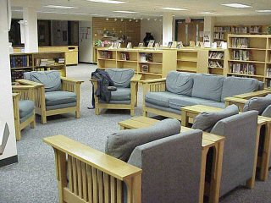
GMS
Building Rep
Karla Harding
Building Rep & Web Master
Laura Litke

Slide 5


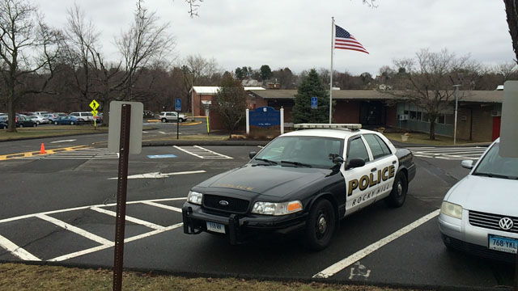
STEVENS SCHOOL
Building Rep
Nancy Forte-Dugay
Building Rep
Heidi Kokoska

Slide 6
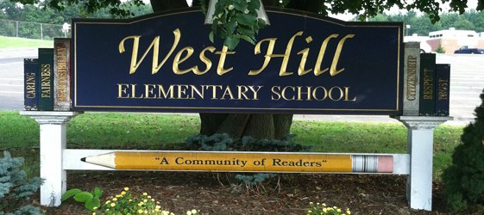

WEST HILL SCHOOL
Vice President
Kirsten Hassett
Membership Co-Chairs & Building Reps
Kirsten Hassett
Sarah Sherman

Slide 7
CURRENT EVENTS
Every Child Achieves Act
Social Security Fairness Act
Senate Bill 1095
Senate Bill 1096

Slide 8
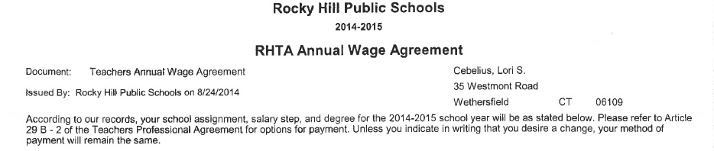
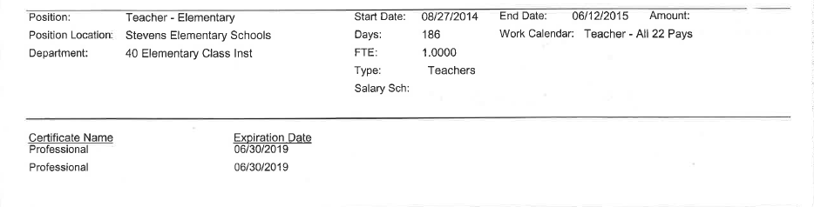
CERTIFICATION
It is YOUR RESPONSIBILITY to know when your CERTIFICATION EXPIRES.
This information can be found at the bottom of your RHTA Annual Wage Agreement

Slide 9
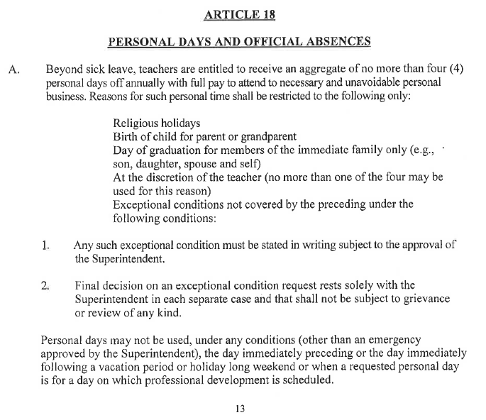
ANNUAL REMINDERS
Read
your
contract!
PERSONAL DAYS

Slide 10

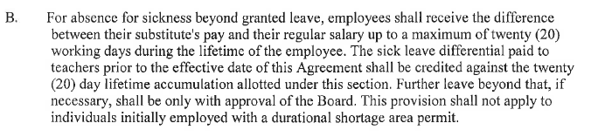

Article 17 B page 12
Disability clause, one-time use only, totaling 4 weeks (20 days) if you are sick and have exhausted your sick leave

Slide 11

Article 17 D page 12
Check your beneficiary!
Rocky Hill as well as TRB (Teacher Retirement Board)

Slide 12
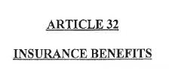
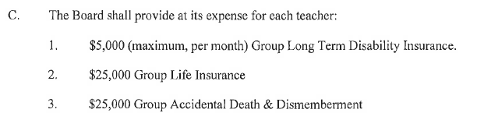
Article 32 C page 25
Check your beneficiary!
Rocky Hill as well as TRB (Teacher Retirement Board)

Slide 13
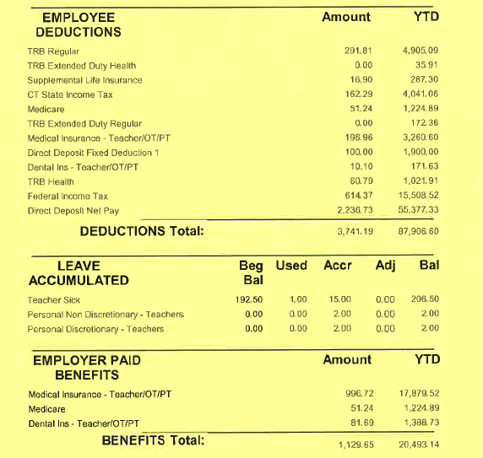
Be sure to monitor your sick days, insurance contributions and the like.

Slide 14
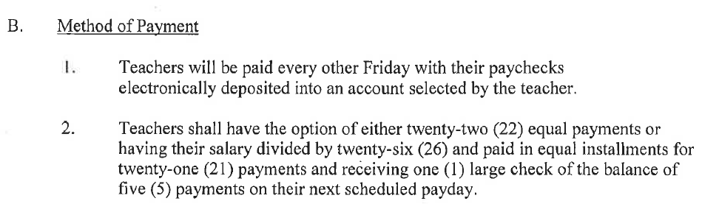
Article 30 B page 21 your last paycheck this year will be June 17th regardless of the last day of school.

Slide 15
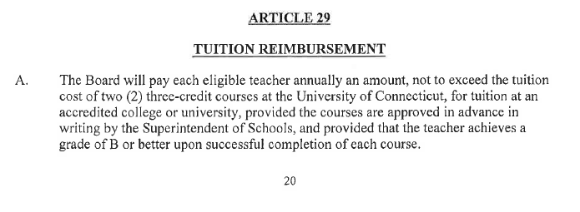
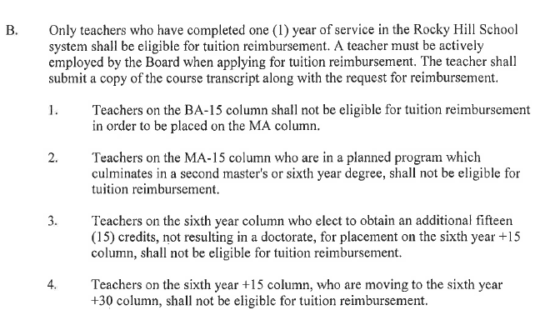
Tuition reimbursement
Eligible only if you’ve have 1 year of service in Rocky Hill
Equivalent to the cost of a 3 credit UConn graduate course
Allowed TWO courses per year
Remember to get it approved
Article 29 A & B
page 20 & 21

Slide 16
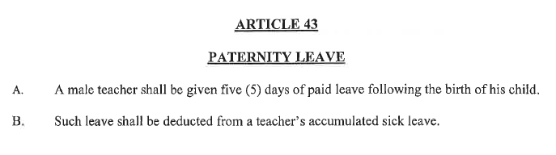

Paternity Leave
Article 43 page 30

Slide 17



Keep track of your professional development activities
Your responsibility now!

Slide 18

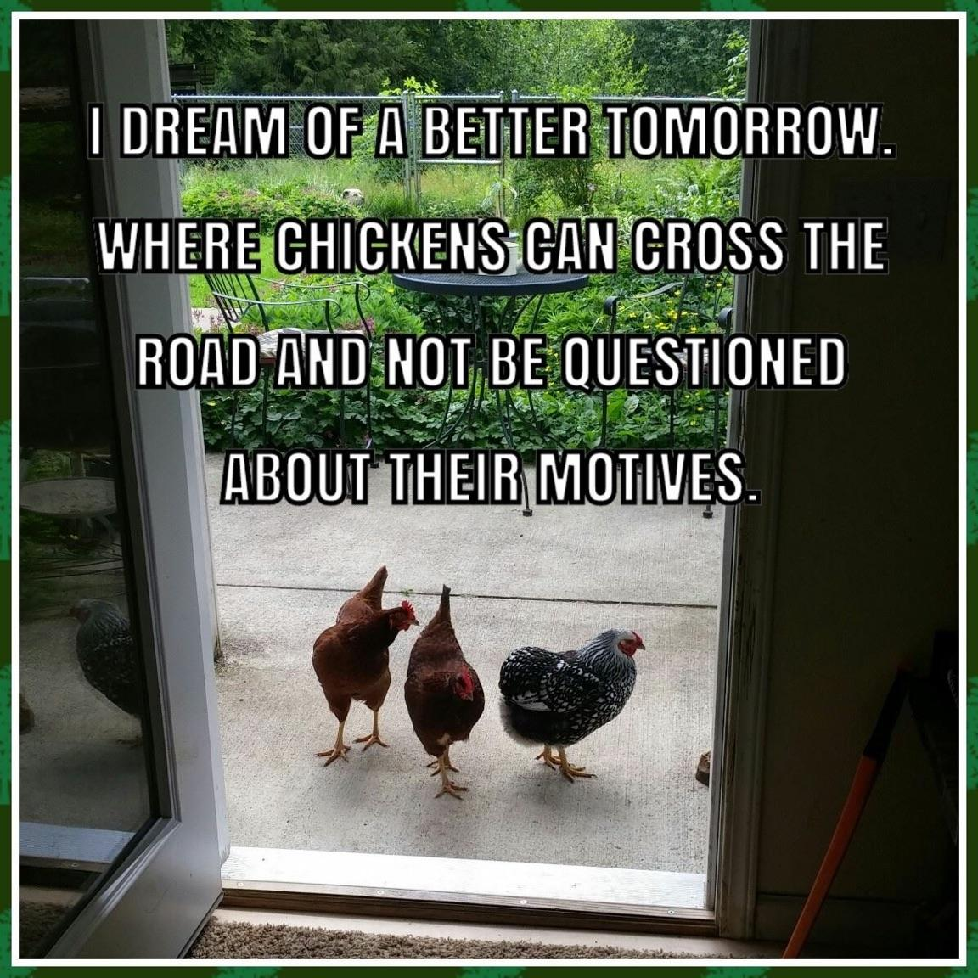
Be Respectful!

Slide 19




Collaborate and share
We are all part of a team and should work together!

Slide 20

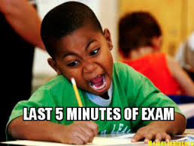

We all own testing results
From pre-K
through senior year.
Revel in our accomplishments, learn from our weaknesses

Slide 21
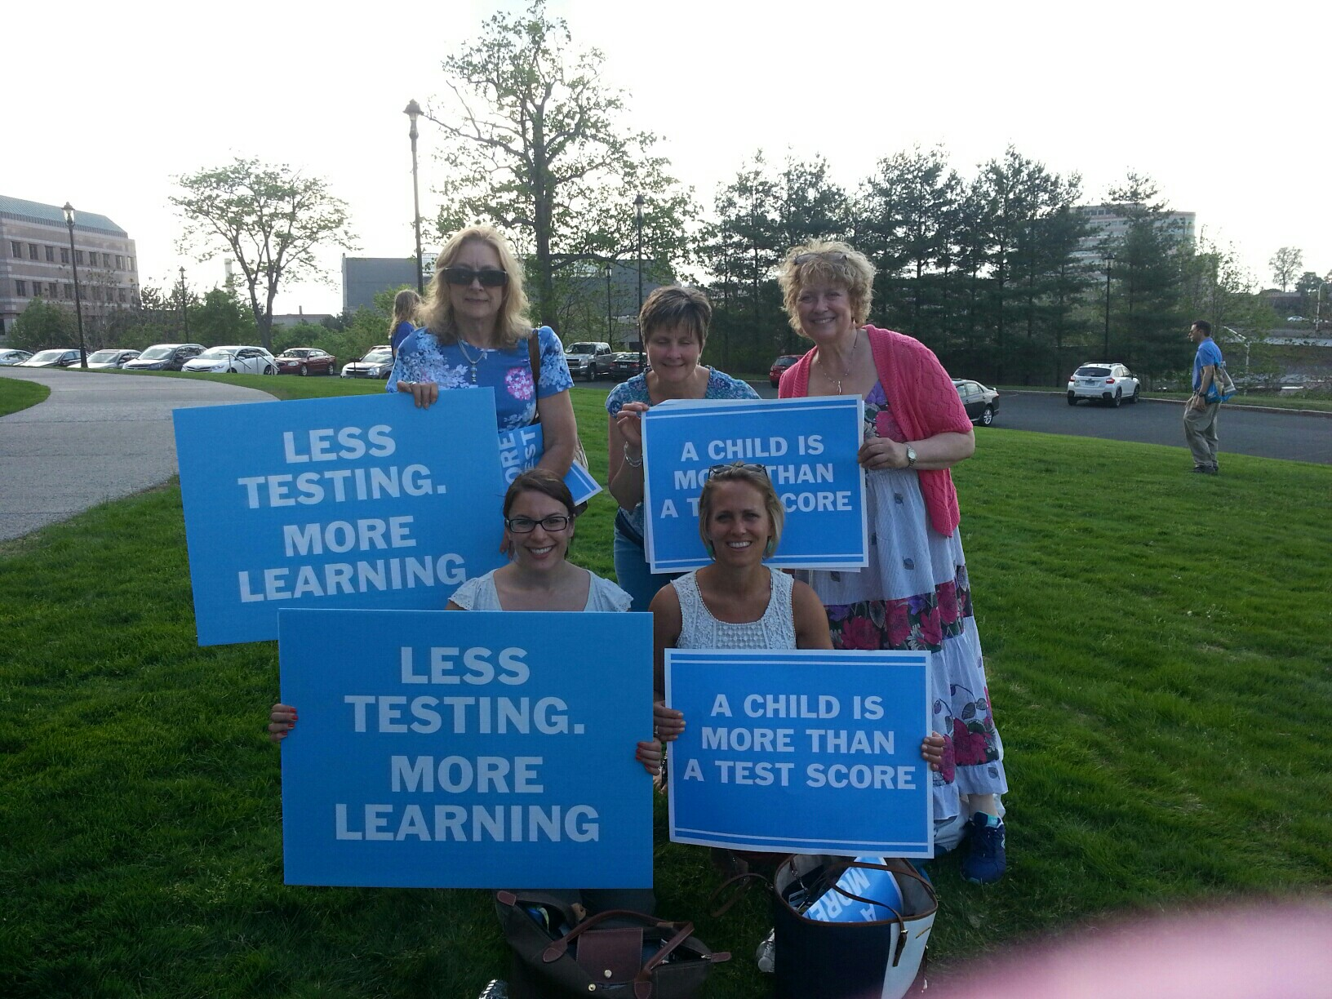
Keep up to date with Legislation
Get
involved!

Slide 22

CEA website
www.cea.org

Slide 23

NEA website
www.nea.org

Slide 24

CT State Department of Education
www.sde.ct.gov

Slide 25

Do not use your personal cell phone to call parents!

Slide 26
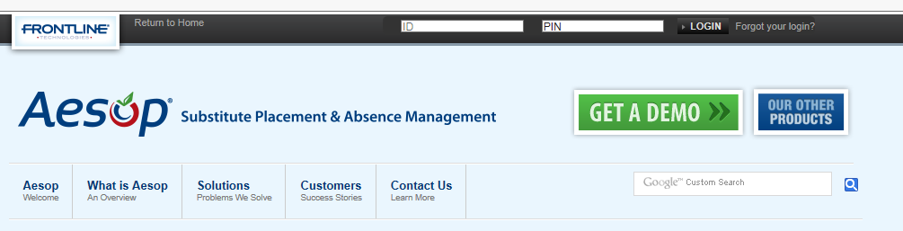
AESOP
Discretionary days
comment section type in “per contract”
Only 1 discretionary day

Slide 27
FYI…
If you volunteer for or participate in extra activities such as student basketball games, spirit nights or are working in your classroom outside of the school day to pack or move, you are not covered under workman’s compensation in the even of personal injury.

Slide 28
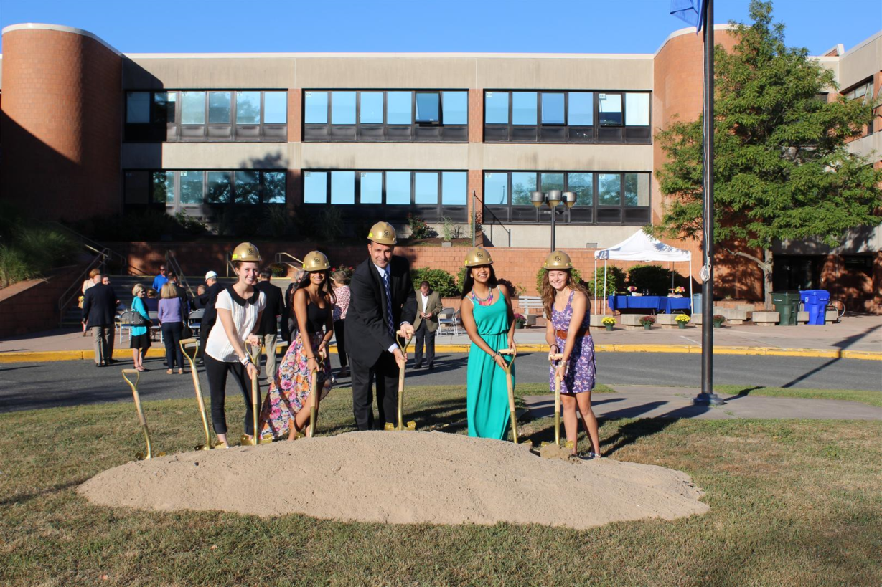
Renovations
Be patient, be focused on the outcome and the updated facilities you will have.

Slide 29

Enrollment is up!!
We’re all feeling the squeeze, some more than others.
Some of us have been without a classroom or have been sharing classrooms for years, some of us are new to this……etc

Slide 30
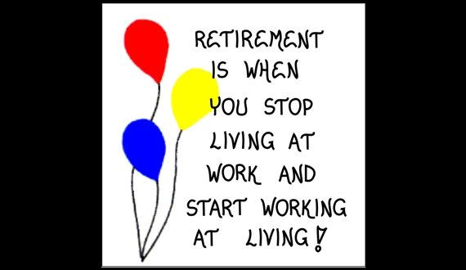
AUGUST CEA Newspaper
The focus is on retirement, you might want to save this.
Cromwell is hosting the CEA retirement seminar Monday February 29, 2016. Register on the CEA website.
Check the CEA website for other dates and locations!

Slide 31



RHTA Social
Friday September 11th
Thank you Adele!
watch your mailbox for more information

Slide 32
RHTA MEETINGS
4TH Wednesday of every month at GMS library media center 3:45
Schedules will be posted in your building

Slide 33
CERTIFICATION
It is YOUR RESPONSIBILITY to know when your CERTIFICATION EXPIRES.
This information can be found at the bottom of your RHTA Annual Wage Agreement

Slide 34

HAVE A GREAT YEAR!
We’re here if you need us!

Slide 36


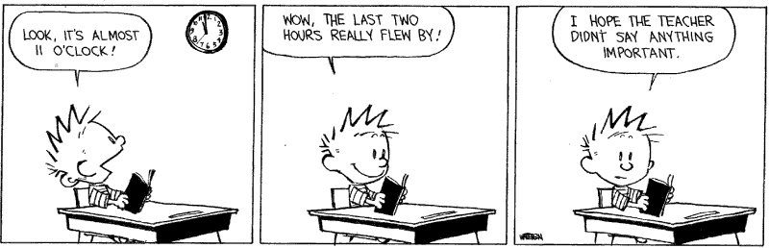

Slide 37



