Slide 1
RHTA
Rocky Hill Teachers Association
Good Morning!
Welcome Back!
2019-2020
Lori Cebelius & Michelle Bartha

Slide 2
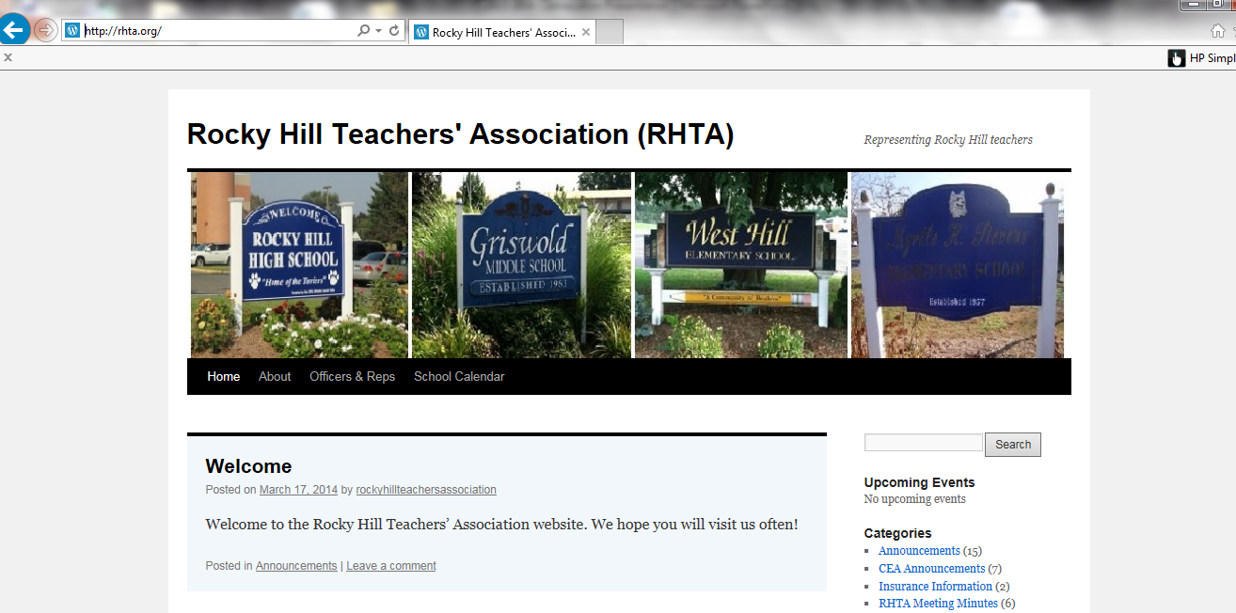
We have our own
RHTA Website
www.rhta.org
This presentation will be uploaded for your convenience

Slide 3

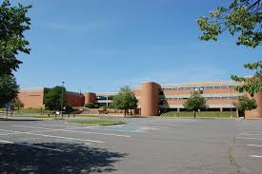
RHTA officers and representatives
RHHS
2019-2020
Secretary
Adele Gali
Treasurer
Brie Mangiaracini-Matthews
Grievance
Brian Schlosser
Building Rep
Dave Fortier
Doug Russell

Slide 4
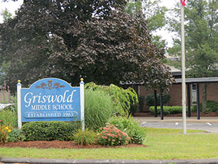

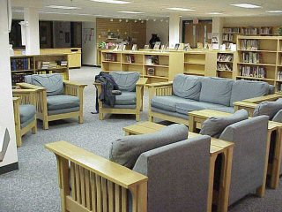
GMS
Building Rep
Karla Harding
Building Rep & Web Master
Laura Litke

Slide 5

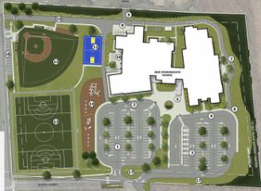
MOSER
Vice President
Kirsten Hassett
Membership Chair
Sarah Sherman
Building Reps
Nancy Forte-Dugay
Heidi Kokoska

Slide 6


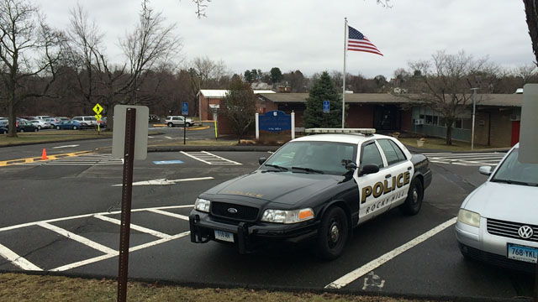
STEVENS SCHOOL
Building Rep
Laura Montgomery
Building Rep
Tom Cassello

Slide 7
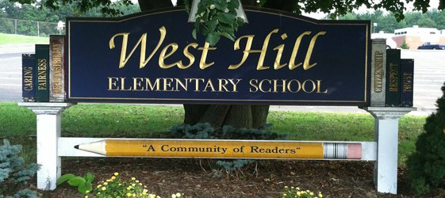

WEST HILL SCHOOL
Building Rep
Liz Tuttle
Building Rep
Marra Whaley

Slide 8

NEGOTIATIONS
Adele Gali
Heidi Kokoska
Karla Harding
Kirsten Hassett
Liz Tuttle
Lori Cebelius
Matt DeBacco
Michelle Bartha
Please do not ask questions
Everything is confidential until the end
Instead, bring them a cup of coffee, thank them, etc for their hard work and late night hours

Slide 9



RHTA Social
Friday September 13th
Thank you Adele!
watch your mailbox for more information

Slide 10

CEA Retirement Seminars
South Windsor Monday September 16, 2019.
North Haven Tuesday October 1, 2019.
Southington Monday March 9, 2020.
Register on the CEA website.
East Hampton Thursday April 9, 2020.
4:15 – 6:30 PM
Check the CEA website for other dates and locations!

Slide 11
RHTA MEETINGS
4TH Wednesday of every month at GMS library media center 3:45
Schedules will be posted in your building

Slide 12
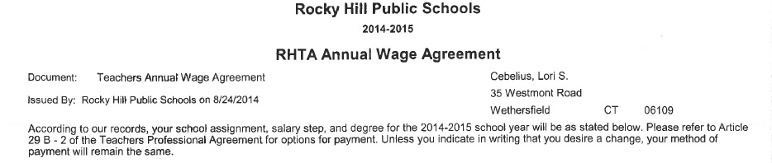
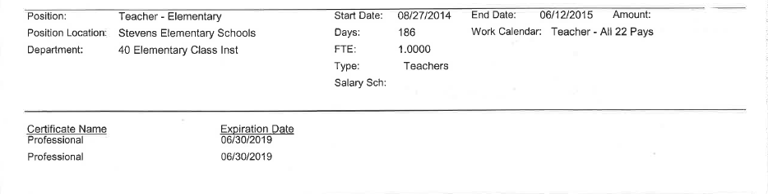
CERTIFICATION
It is YOUR RESPONSIBILITY to know when your CERTIFICATION EXPIRES.
This information can be found at the bottom of your RHTA Annual Wage Agreement

Slide 13
PAYSTUB ON THE WEB PORTAL
2 ways to get there…..
Employee self service portal for infinite visions.
The link is https://ivisions.tylertech.com/RockyHillESS
Email from Tsampica Mal on April 19th with user name and password.
OR
Sign in through school website, rockyhillps.com

Slide 14
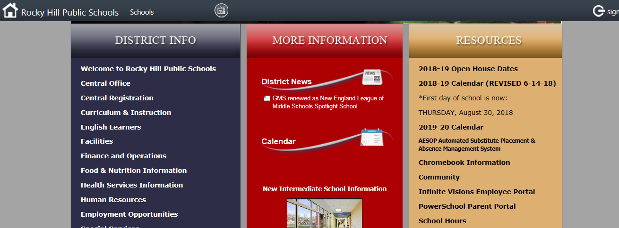
PAYSTUB ON THE WEB PORTAL

Slide 15
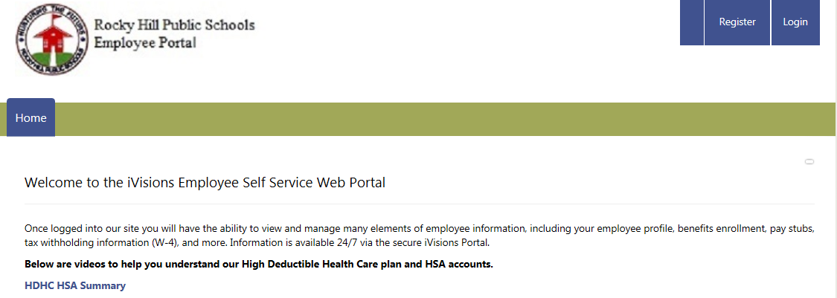
Log in just as you would the computer in your classroom. If this is your first time logging in use “Changeme15!” as your initial password. You will be prompted to change password. Do not register as an employee, you have already been registered.
PAYSTUB ON THE WEB PORTAL CONTINUED…
Log in

Slide 16
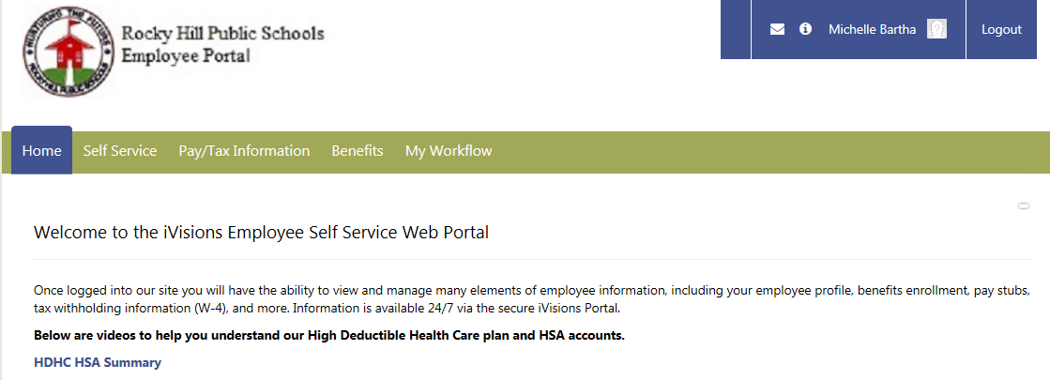
PAYSTUB ON THE WEB PORTAL CONTINUED…

Slide 17
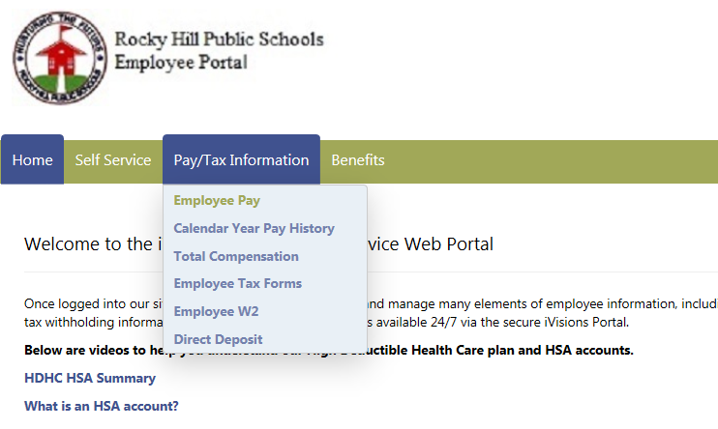
This is where you will be able to keep track of TRB, insurance, and 403B contributions etc

Slide 18
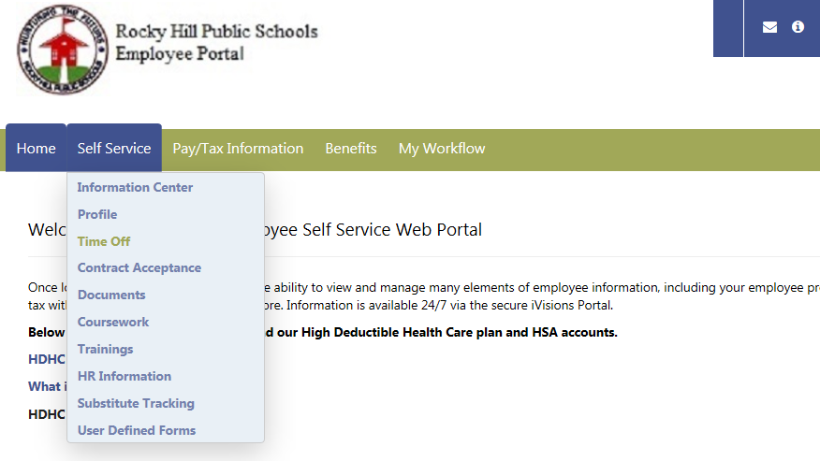
This is where you will be able to keep track sick days and discretionary days

Slide 19
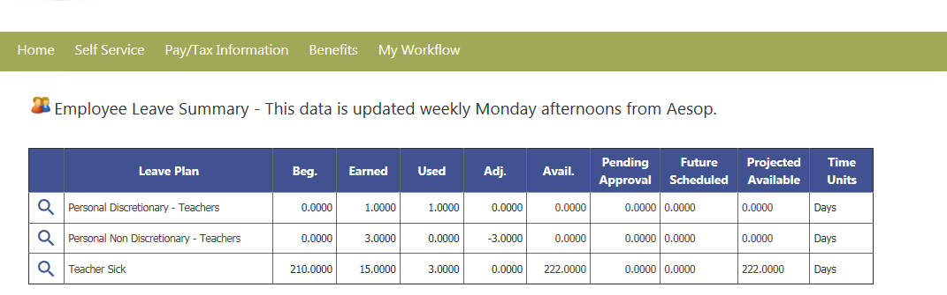
Be sure to monitor your sick days, insurance contributions and the like.

Slide 20
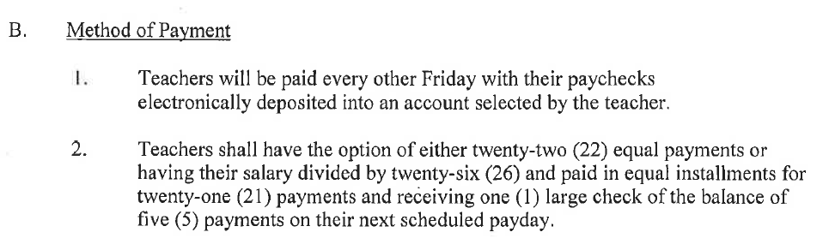
Article 30 B page 22 your last paycheck this year will be June 12th regardless of the last day of school.
This information can be found on the district website under
staff resources
forms and documents
payroll forms

Slide 21
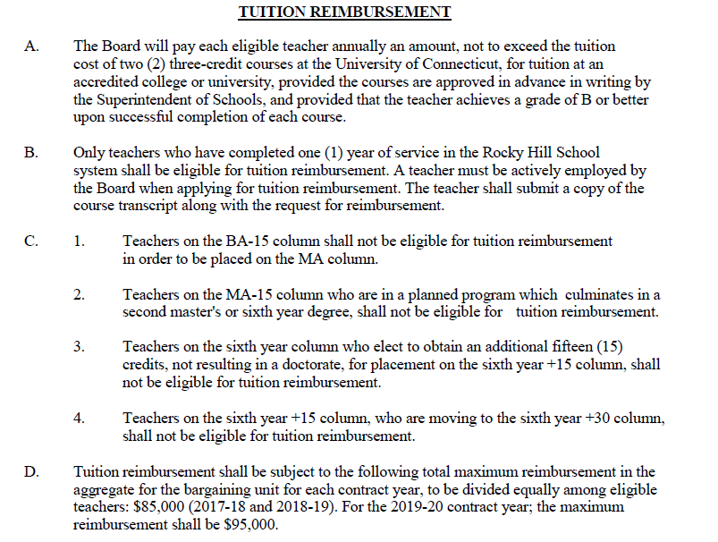
Tuition reimbursement
Eligible once you have 1 year of service in Rocky Hill
Equivalent to the cost of a 3 credit UConn graduate course
Allowed TWO courses per year
Remember to get it approved
$95,000 cap
Article 29 A, B & D
page 21

Slide 22
Tuition reimbursement
Eligible once you have 1 year of service in Rocky Hill
$95,000 Cap per year (2019-2020)
1 payout for the year; end of June, separate check
Procedure & Documents can be found on the website
Send in proof of payment & grades as you get them.
Unofficial transcript is ok; Official transcript only needed when you finish program and move degree columns
May 30th deadline for paperwork. Payment in June.
Classes this summer will be reimbursed June 2020

Slide 23
Tuition reimbursement
Eligible once you have 1 year of service in Rocky Hill
$95,000 will be split among those taking classes, up to full reimbursement for two UConn Graduate classes.
Essentially the time frame is for classes is mid-May to April; paid the following June.
Unofficial transcript is ok; Official transcript only needed when you finish program and move degree columns
May 30th deadline for paperwork. Payment in June.
Any questions do not hesitate to call Christine Flynn at the BOE 860-258-7720

Slide 24
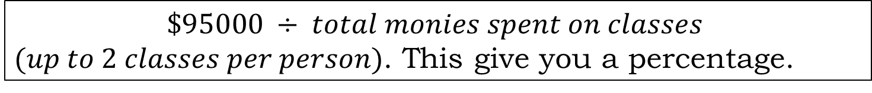
Tuition reimbursement
Eligible once you have 1 year of service in Rocky Hill
How reimbursement is calculated
$$\$95000 ÷ total monies spent on classes$$
$(up to 2 classes per person)$. This give you a percentage.
That percentage is applied to the amount you paid out of pocket. This is the amount of reimbursement you receive.
This can vary year to year depending on how many people are taking classes and seeking reimbursement.
Any questions do not hesitate to call Christine Flynn at the BOE 860-258-7720

Slide 25

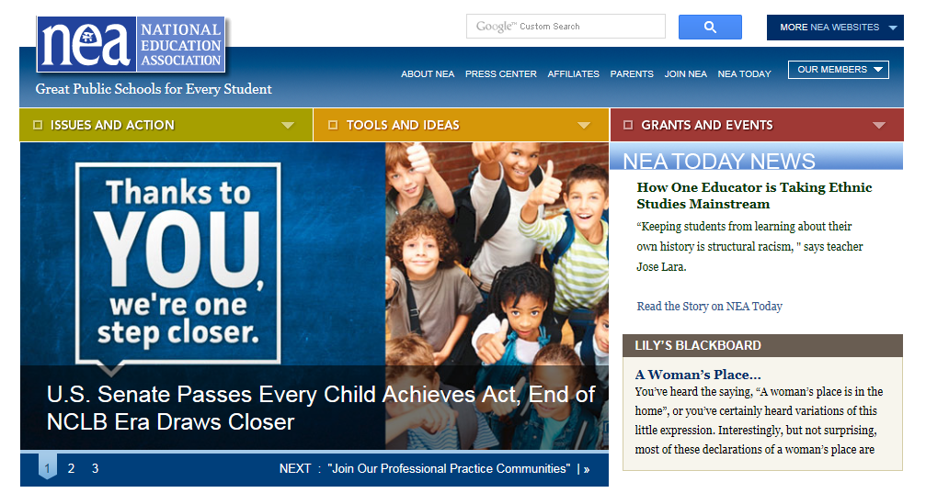

CEA website
www.cea.org
NEA website
www.nea.org
CT State Department of Education
www.sde.ct.gov

Slide 26
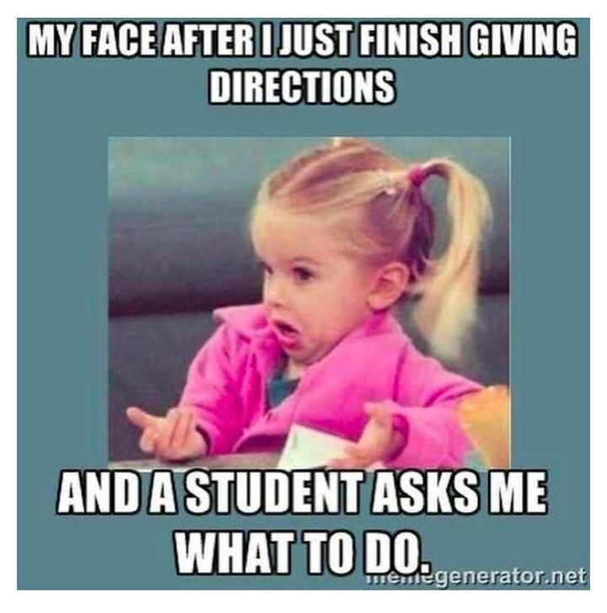
HAVE A GREAT YEAR!
We’re here if you need us!

