Slide 1
RHTA
Rocky Hill Teachers Association
Good Morning!
Welcome Back!
2021-2022
Michelle Bartha & Doug Russell

Slide 2
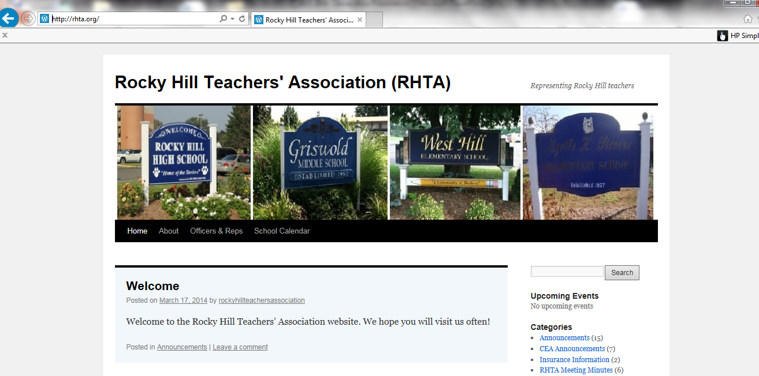
We have our own
RHTA Website
www.rhta.org
This presentation will be uploaded for your convenience

Slide 3

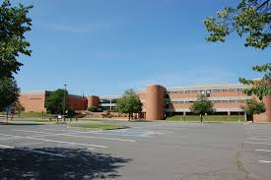
RHTA officers and representatives
RHHS
2021-2022
Secretary
Adele Gali
Building Rep
Dave Fortier
Building Rep
Matt Bennett

Slide 4
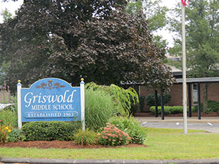


GMS
Building Rep
Karla Harding
Building Rep
Michelle Walerysiak
Web Master
Laura Litke

Slide 5

MOSER
Vice President
Kirsten Hassett
Membership Chair
Sarah Sherman
Grievance Chair
Heidi Kokoska
Building Reps
Joe Couture
Carissa Lastrina

Slide 6


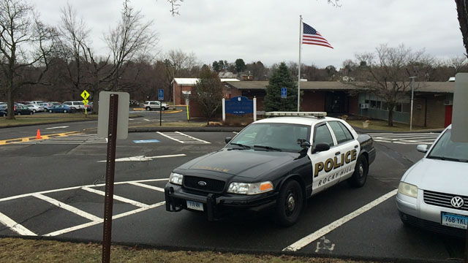
STEVENS SCHOOL
Treasurer
Sandy Fravel
Building Rep
Kristen Carter
Building Rep
Laura O’Brien

Slide 7
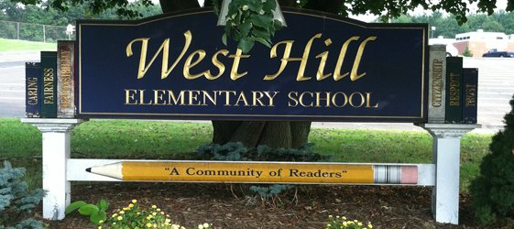

WEST HILL SCHOOL
Building Rep
??????
Building Rep
??????

Slide 8
Teacher Mandated Vaccine
Governor Lamont issued an executive order (#13D) requiring all CT state employees and staff of all childcare facilities and preK-12 schools statewide must have received at least one dose of a COVID-19 vaccine by September 27, 2021. Those who do not get vaccinated due to certain exemptions will be required to be tested for COVID-19 on a weekly basis.
“Being vaccinated against COVID-19 is the most effective means of preventing infection and subsequent transmission,” Governor Lamont said …I have also emphasized for well over a year the importance of keeping our kids in the classroom, full-time, and making sure it is as safe an environment as possible for learning for everyone in the school building. Ensuring all of our educators, including early childhood educators, and school staff are vaccinated will keep students in the classroom and keep childcare open for families. Getting vaccinated keeps yourself safe, keeps your community safe, and will help beat back the ongoing spread of this virus.”

Slide 9
“Unlike last year, this year we have a new, outstanding public health tool to battle the COVID pandemic,” Connecticut Public Health Acting Commissioner Dr. Deidre Gifford said. “The COVID vaccine can help us pave our way back to a normal life for our workers, teachers and students.”
“The mission of the Connecticut State Department of Education is to ensure all of our children obtain a world-class education, and that requires them being in the classroom with their teachers and friends,” Connecticut Education Commissioner Charlene Russell-Tucker said. “Teacher and staff vaccination is the most effective way of keeping our school staff and students healthy and in school.”

Slide 10

Teacher Evaluation Plan
Thanks to CEA’s continued advocacy and close collaboration with other stakeholder groups, the Connecticut State Department of Education has allowed greater flexibility in teacher evaluations for the 2021-2022 school year.
Every school district’s Professional Development and Evaluation Committee (PDEC) must meet in order to discuss and reach consensus on whether to adopt the flexibilities or keep their existing plan. Each district must also provide an orientation on any changes to current teacher evaluation plans by September 15, 2021.

Slide 11
Additional guidance will be forthcoming from the CSDE, but the most significant changes to be aware of include:
Very clear language requiring mutual agreement between evaluator and teacher on goals and indicators/measures of achievement
Only one student learning goal is allowable; it may have either a social emotional learning (SEL) or academic focus
A minimum of two indicators/measures of accomplishment are required, but they do not need to be standardized assessments, nor do the indicators/measures of accomplishment have to be mathematically quantifiable

Slide 12
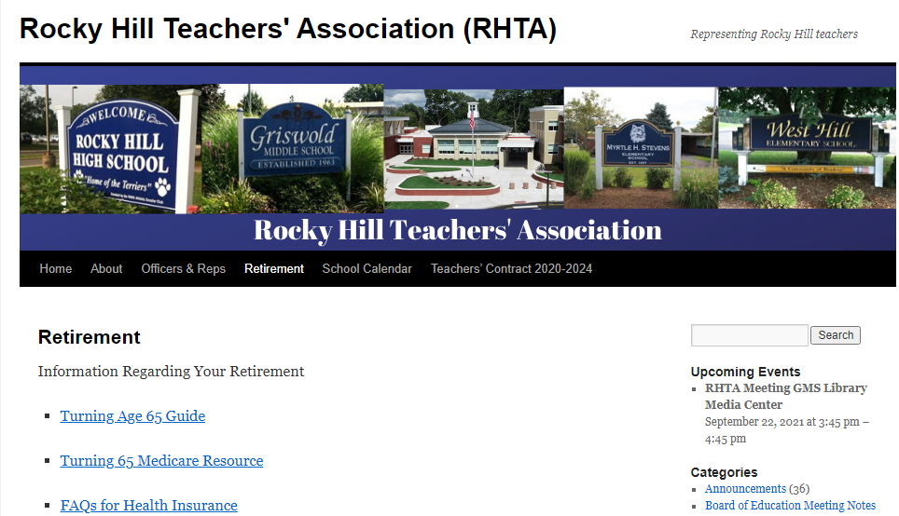
Retirement!

Slide 13
CEA Retirement Workshops
VIRTUAL RETIREMENT WORKSHOPS!
Time: 4:00 – 6:30 PM
Monday, September 20, 2021
Limited to the first 100 registrants per workshop!
Wednesday, September 29, 2021
Thursday, October 7, 2021
Wednesday, October 27, 2021
Register on the CEA website
or call
Heidi Krutzky
860.725.6327
Thursday, November 4, 2021
Tuesday, November 16, 2021
Tuesday, November 30, 2021
Check the CEA website for more dates!
Monday, December 13, 2021

Slide 14
CEA Retirement Workshops
It is never too early!
We encourage you to attend at least 5 retirement workshops before you retire!
Rule of thumb!
At least one retirement workshop at the beginning of your career, at least one mid career and at least one at the end of your career.
We encourage you to attend a workshop with
Robin Kaplan-Cho through CEA.
Remember a 403B vendor might not be an expert in Teacher Retirement, they experts in the product they sell.

Slide 15
403B OMNI
https://omni403B.com/PlanDetail/1185
or
contact Jo-Ann Turcotte for help
457 Account
Jonathan Cheverie through Prudential in Hartford
860.461.8644
jonathan.cheverie@prudential.com

Slide 16
5 Important questions you should ask your financial advisor?
1) What was the total dollar amount I paid in fees last year?
2) What is my personal rate of return for each of my mutual funds and the rate of return for my combined portfolio? I would like the numbers before fees and the numbers after fees.
3) What is the benefit to me of this type of annuity investment?
4) Is this type of investment in my best interest?
5) What are the actual costs involved from (403(b) company) if any, if I roll my 403b into a different 403b company or other type of IRA investment?
6) Are you a fiduciary

Slide 17
TRB ~ Teacher Retirement Board
The TRB annuity that was repealed in 2019 has been reinstated. CEA fought to get this back for retiring teachers.
What: Public Act 21-186 restored the ability of teachers to roll funds (for any retirements beginning on September 1, 2021 or later) from certain tax-deferred accounts such as a 403(b) into the Teachers’ Retirement System at retirement in order to purchase the TRB’s fixed annuity.
How: Teachers again can now purchase an annuity at
retirement with certain tax deferred rollover funds.
Who: Retiring teachers who want to supplement their pension.
Ask your financial advisor to explain this to you!

Slide 18
TRB ~ Teacher Retirement Board
CEA has finally been able to get it passed effective September 1.
Here’s the form to use at retirement
https://portal.ct.gov/-/media/TRB/Content/ActiveInactive/AI_TAXDEFROLL.pdf
The annuity tables can be found here:
https://portal.ct.gov/-/media/TRB/Content/ActiveInactive/AI_VOLSUP20.pdf
Make sure that when you attend a CEA sponsored retirement workshop that you ask about the annuity!
Remember a 403B vendor might not be an expert in Teacher Retirement, they are only an expert in their product. We encourage you to attend a workshop given by Robin Kaplan-Cho through CEA.

Slide 19

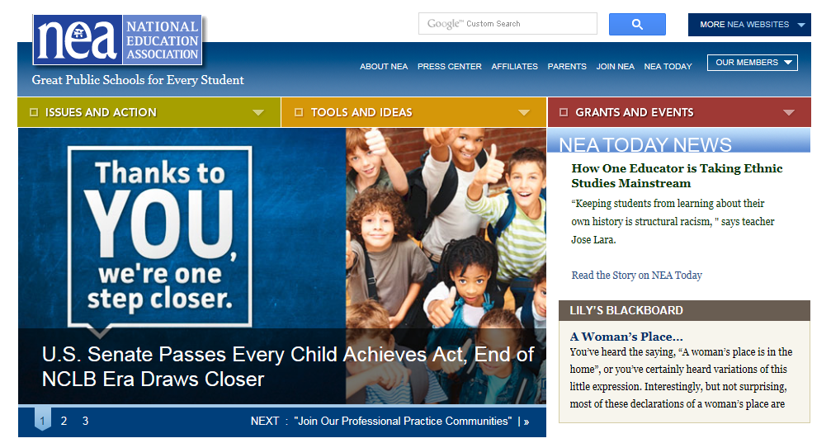

CEA website
www.cea.org
NEA website
www.nea.org
CT State Department of Education
www.sde.ct.gov

Slide 20

A minute to recognize some teacher milestones!

Slide 21

Dan Czuchta
Sofia Striffler
RHHS
5
years
GMS
Krista Kennedy
MOSER
Taylor Friedmann
Julie Hurlock
Carolyn Dobmeier
Danielle Gagliardi
Stephanie Phelps
Cate Yule
STEVENS
WEST HILL
Micayla Bryant
Nicole Valenti

Slide 22

10
Rebecca Ebert
RHHS
years
Leslie Fuchs
Kerry Slisz
GMS
MOSER
Lisa Patnoe

Slide 23

Matt Bennett
Elaine Malespini
RHHS
15
years
GMS
Jon Patrei
MOSER
Andy Basroon
Vinny Faienza
Wendy Piscitelli
Andres Rossi
Diane Sousa
STEVENS
WEST HILL
Merle Cohen

Slide 24

Dan Hott
Amy Rosenberg
RHHS
20
years
Lisa Brockel
Leah O’Leary
Steve Patarini
GMS
STEVENS
Sandy Fravel

Slide 25

25
years
GMS
Rachel Portal
MOSER
Laura Cascio
STEVENS
Melissa Ghent

Slide 26

31-34
Don Brown ~ 31
Deb Wolfe ~ 31
RHHS
years
MOSER
Lee-Ann Flynn ~ 33
Kirsten Hassett ~ 33
Donna Waite ~ 34

Slide 27

35
RHHS
years
GMS
Kim Quinn
STEVENS

Slide 28

35+
35+
RHHS
Ellen Janiga ~ 40
years
GMS
Jeannie Robertson ~ 39

Slide 29



RHTA Social
Friday September 10th
Thank you Adele!
watch your mailbox for more information

Slide 30
RHTA MEETINGS
4TH Wednesday of every month at GMS
library media center 3:45
September 22nd
January 26th
October 27th
February 23rd
November –no meeting
March 23rd
December –no meeting
April 27th
May 25th ~ Elections
Schedules will also be posted in your building

Slide 31
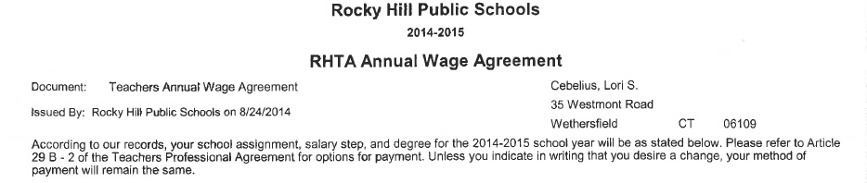
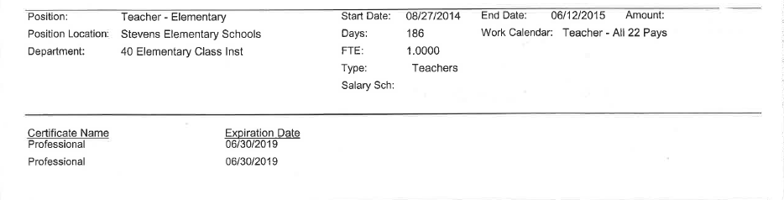
CERTIFICATION
It is YOUR RESPONSIBILITY to know when your CERTIFICATION EXPIRES.
This information can be found at the bottom of your RHTA Annual Wage Agreement

Slide 32
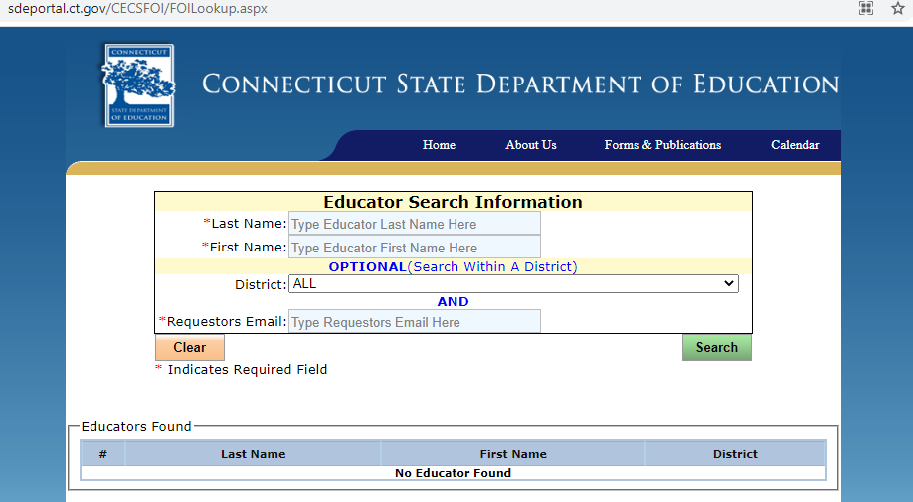
Look up your certification online!
http://sdeportal.ct.gov/CECSFOI/FOILookup.aspx

Slide 33

HAVE A GREAT YEAR!
We’re here if you need us!

Slide 34
CONTINUE TO THE NEXT SLIDE FOR MORE INFORMATION!

Slide 35
PAYSTUB ON THE WEB PORTAL
2 ways to get there…..
Employee self service portal for infinite visions.
The link is https://ivisions.tylertech.com/RockyHillESS
Email from JoAnn Turcotte or Tsampica Mal if you need help.
OR
Sign in through school website, rockyhillps.com

Slide 36
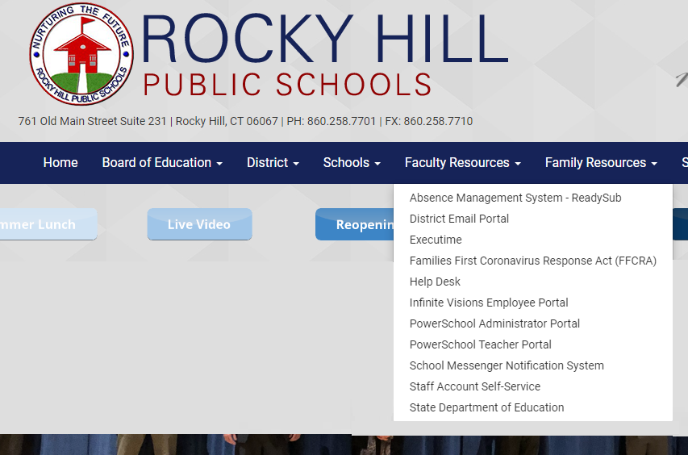
PAYSTUB ON THE WEB PORTAL
www.rockyhillps.com
Faculty Resources
Infinite Visions Employee Portal

Slide 37
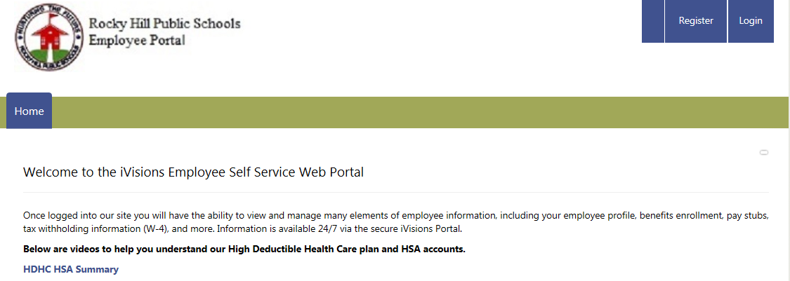
Log in just as you would the computer in your classroom. If this is your first time logging in use “Changeme15!” as your initial password. You will be prompted to change password. Do not register as an employee, you have already been registered.
PAYSTUB ON THE WEB PORTAL CONTINUED…
Log in

Slide 38
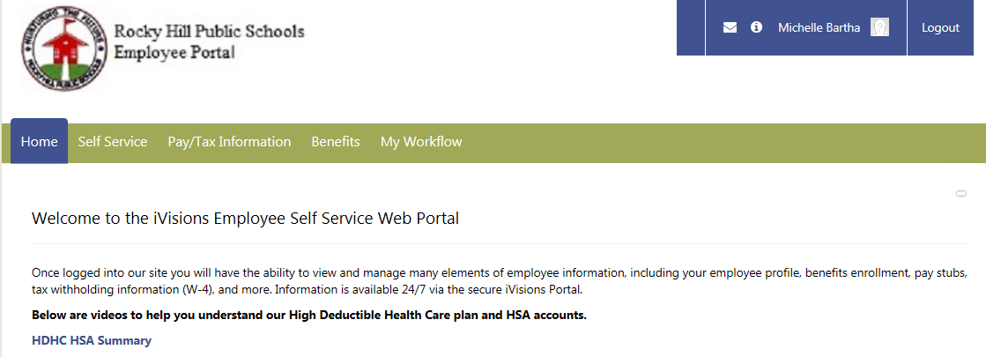
PAYSTUB ON THE WEB PORTAL CONTINUED…

Slide 39
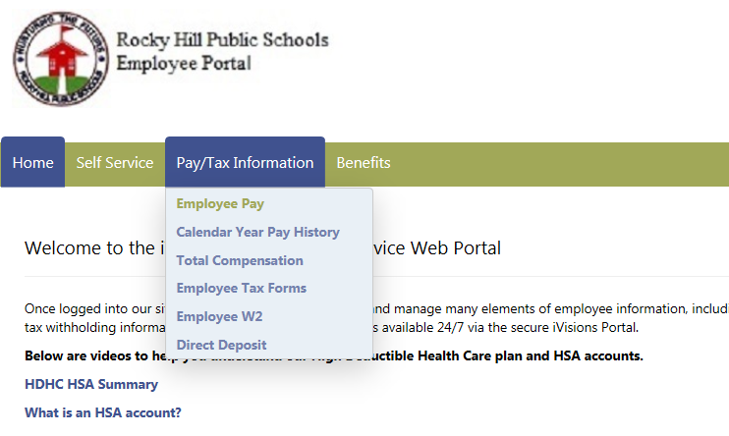
This is where you will be able to keep track of TRB, insurance, and 403B contributions etc

Slide 40
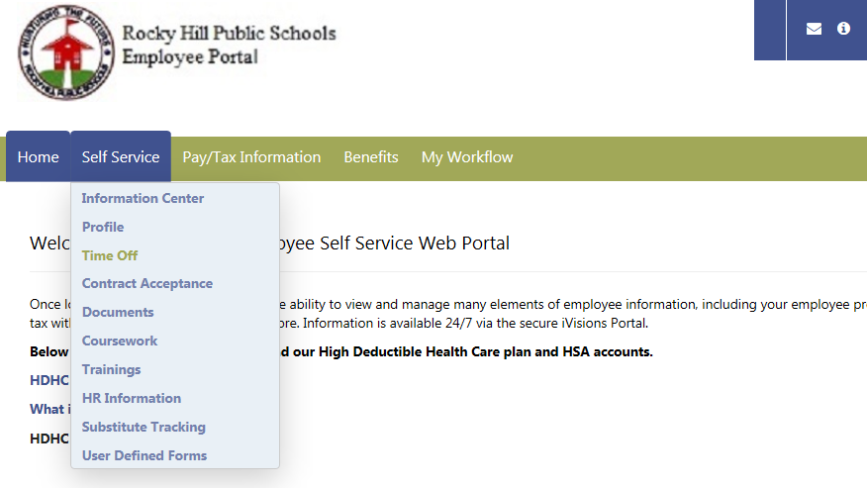
This is where you will be able to keep track sick days and discretionary days

Slide 41
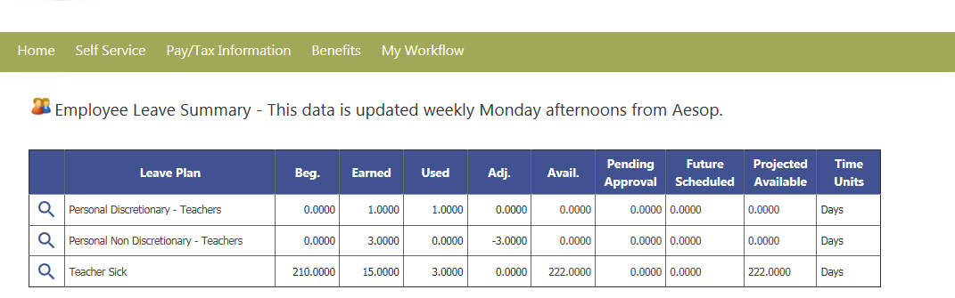
Be sure to monitor your sick days, insurance contributions and the like.

Slide 42
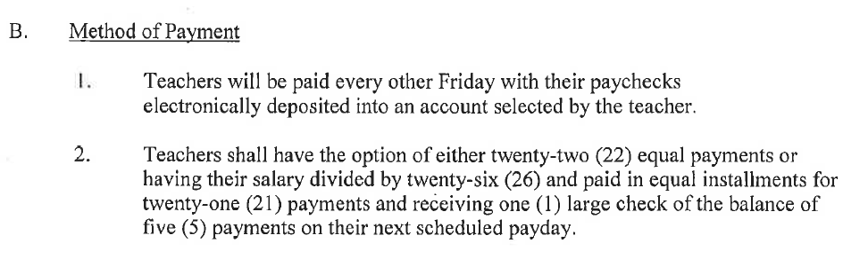
Article 30 B page 22 your last paycheck this year will be June 10th regardless of the last day of school.
This information can be found on the district website under
staff resources
forms and documents
payroll forms

Slide 43
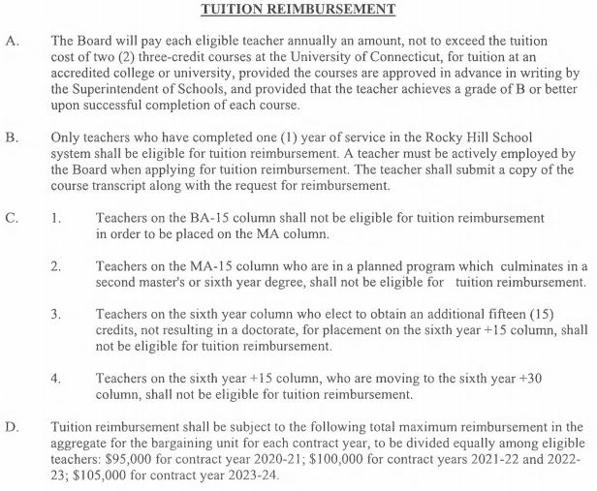
Tuition reimbursement
Eligible once you have 1 year of service in Rocky Hill
Equivalent to the cost of a 3 credit UConn graduate course
Allowed TWO courses per year
Remember to get it approved
$100,000 cap
Article 28 A, B & D
page 19

Slide 44
Tuition reimbursement
Eligible once you have 1 year of service in Rocky Hill
$100,000 Cap per year (2021-2022)
1 payout for the year; end of June, separate check
Procedure & Documents can be found on the website
Send in proof of payment & grades as you get them.
Unofficial transcript is ok; Official transcript only needed when you finish program and move degree columns
May 30th deadline for paperwork. Payment in June.
Classes this summer will be reimbursed June 2022

Slide 45
Tuition reimbursement
Eligible once you have 1 year of service in Rocky Hill
$100,000 will be split among those taking classes, up to full reimbursement for two UConn Graduate classes.
Essentially the time frame is for classes is mid-May to April; paid the following June.
Unofficial transcript is ok; Official transcript only needed when you finish program and move degree columns
May 30th deadline for paperwork. Payment in June.
Any questions do not hesitate to call Christine Flynn at the BOE 860-258-7720

Slide 46
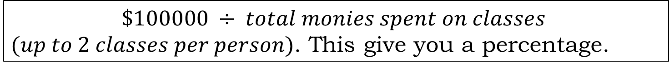
Tuition reimbursement
Eligible once you have 1 year of service in Rocky Hill
How reimbursement is calculated
$$\$100000 ÷ total monies spent on classes$$
$(up to 2 classes per person)$. This give you a percentage.
That percentage is applied to the amount you paid out of pocket. This is the amount of reimbursement you receive.
This can vary year to year depending on how many people are taking classes and seeking reimbursement.
Any questions do not hesitate to call Christine Flynn at the BOE 860-258-7720

Slide 47

NEGOTIATIONS~
Fall of 2019 we negotiated a 4 year contract
July 1, 2020- June 30, 2024
Adele Gali
Doug Russell
Heidi Kokoska
Karla Harding
Kirsten Hassett
Liz Tuttle
Matt DeBacco
Michelle Bartha
We anticipate working on an MOU (Memorandum of Understanding) for this year.
We know again, things will not be perfect as the year begins and there will be things we need to address

