Slide 1

RHTA
Rocky Hill Teachers Association
Good Morning!
Welcome Back!
2022-2023
Michelle Bartha & Doug Russell

Slide 2
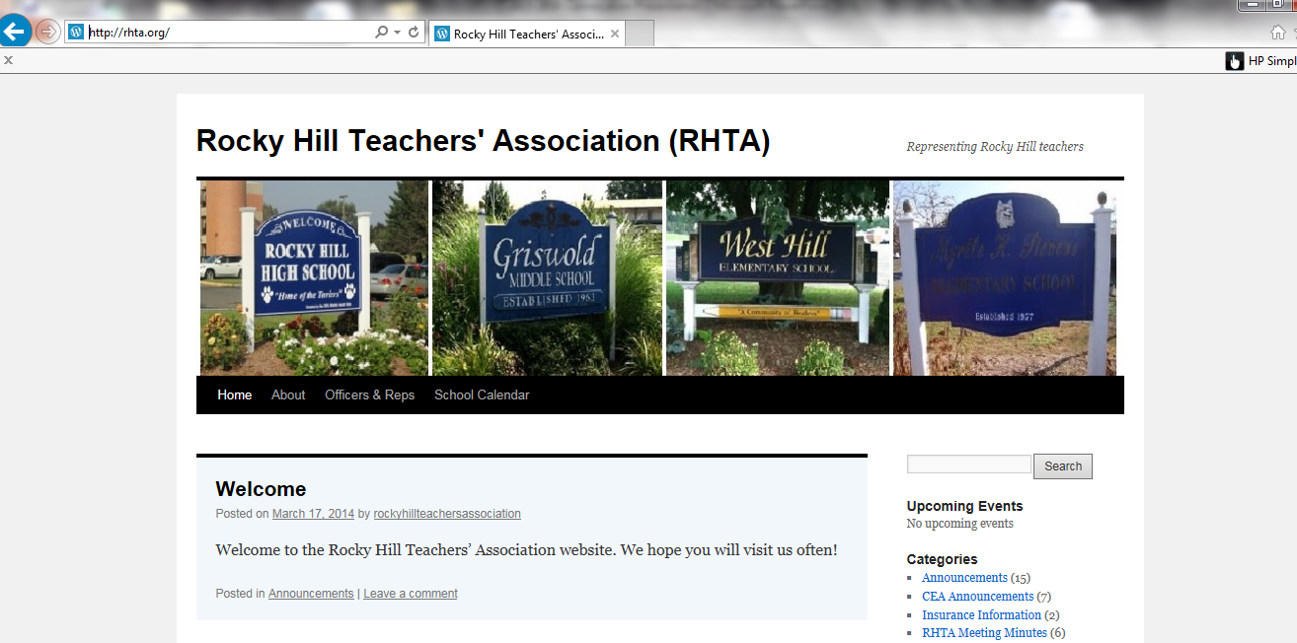
We have our own
RHTA Website
www.rhta.org
This presentation will be uploaded for your convenience

Slide 3

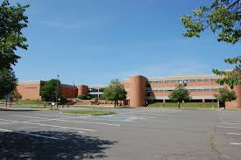
RHTA officers and representatives
RHHS
2022-2023
Secretary
Adele Gali
Building Rep
Dave Fortier
Building Rep
Matt Bennett

Slide 4
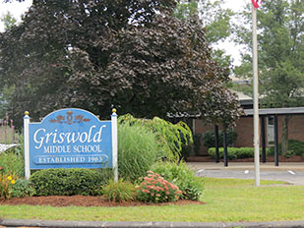


GMS
Building Rep
Karla Harding
Building Rep
Michelle Walerysiak
Web Master
Laura Litke

Slide 5

MOSER
Vice President
Kirsten Hassett
Membership Chair
Sarah Sherman
Grievance Chair
Heidi Kokoska
Building Reps
Joe Couture
Carissa Lastrina

Slide 6


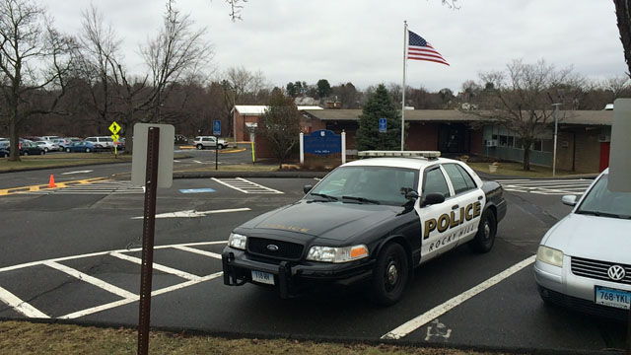
STEVENS SCHOOL
Treasurer
Sandy Fravel
Building Rep
Kristen Carter
Building Rep
Laura O’Brien

Slide 7
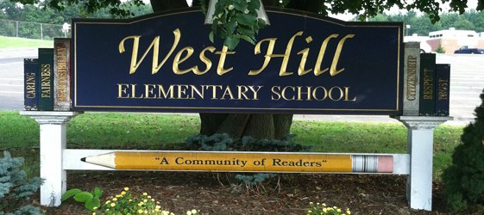

WEST HILL SCHOOL
Building Rep
Christina Boucher
Building Rep
???

Slide 8


Teacher Evaluation Plan
Thanks to CEA’s continued advocacy and close collaboration with other stakeholder groups, the Connecticut State Department of Education will continue flexibility in teacher evaluations for the 2022-2023 school year.
30 minute lunch
As far as we know principals have adjusted schedules as needed to accommodate the 30 minute lunch.

Slide 9
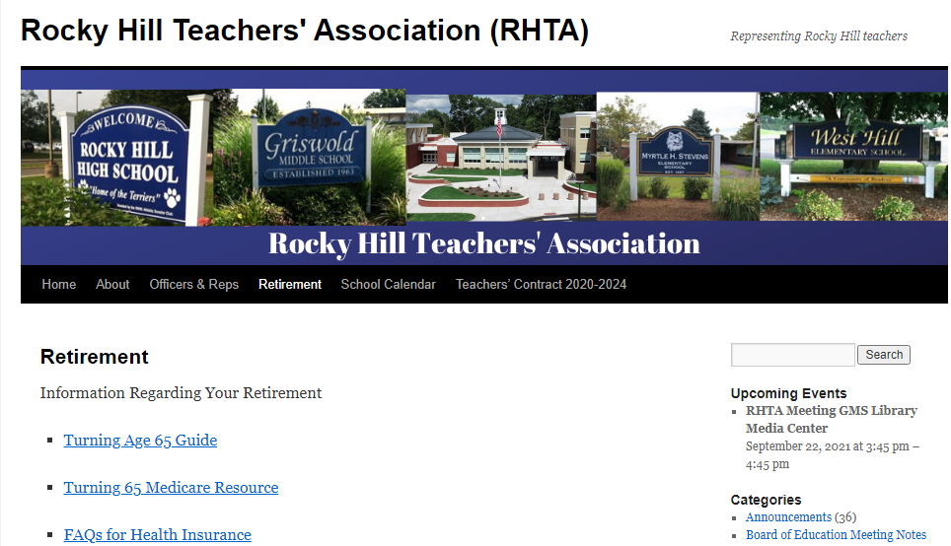
Retirement!

Slide 10
CEA Retirement Workshops
VIRTUAL RETIREMENT WORKSHOPS!
Time: 4:00 – 6:30 PM
Limited to the first 100 registrants per workshop!
Wednesday, September 21, 2022
Monday, October 3, 2022
Tuesday, October 18, 2022
Register on the CEA website
or call
Heidi Krutzky
860.725.6327
Thursday, November 3, 2022
Wednesday, December 7, 2022
Monday, December 19, 2022
Check the CEA website for more dates!

Slide 11
CEA Retirement Workshops
It is never too early!
We encourage you to attend at least 5 retirement workshops before you retire!
Rule of thumb!
At least one retirement workshop at the beginning of your career, at least one mid career and at least one at the end of your career.
We encourage you to attend a workshop with
Robin Kaplan-Cho through CEA.
Remember a 403B vendor might not be an expert in Teacher Retirement, they experts in the product they sell.

Slide 12
403B OMNI
https://omni403B.com/PlanDetail/1185
or
contact Jo-Ann Turcotte for help
457 Account
Jonathan Cheverie through Prudential in Hartford
860.461.8644
jonathan.cheverie@prudential.com

Slide 13
5 Important questions you should ask your financial advisor?
1) What was the total dollar amount I paid in fees last year?
2) What is my personal rate of return for each of my mutual funds and the rate of return for my combined portfolio? I would like the numbers before fees and the numbers after fees.
3) What is the benefit to me of this type of annuity investment?
4) Is this type of investment in my best interest?
5) What are the actual costs involved from (403(b) company) if any, if I roll my 403b into a different 403b company or other type of IRA investment?
6) Are you a fiduciary (they act in your best interest)
The more information you have the better, informed decisions you can make

Slide 14
TRB ~ Teacher Retirement Board
The TRB annuity that was repealed in 2019 has been reinstated. CEA fought to get this back for retiring teachers.
What: Public Act 21-186 restored the ability of teachers to roll funds (for any retirements beginning on September 1, 2021 or later) from certain tax-deferred accounts such as a 403(b) into the Teachers’ Retirement System at retirement in order to purchase the TRB’s fixed annuity.
How: Teachers again can now purchase an annuity at
retirement with certain tax deferred rollover funds.
Who: Retiring teachers who want to supplement their pension.
Ask your financial advisor to explain this to you!

Slide 15
TRB ~ Teacher Retirement Board
CEA was able to get it passed effective September 1, 2021.
Here’s the form to use at retirement
https://portal.ct.gov/-/media/TRB/Content/ActiveInactive/AI_TAXDEFROLL.pdf
The annuity tables can be found here:
https://portal.ct.gov/-/media/TRB/Content/ActiveInactive/AI_VOLSUP20.pdf
Make sure that when you attend a CEA sponsored retirement workshop that you ask about the annuity!
Remember a 403B vendor might not be an expert in Teacher Retirement, they are only an expert in their product. We encourage you to attend a workshop given by Robin Kaplan-Cho through CEA.

Slide 16

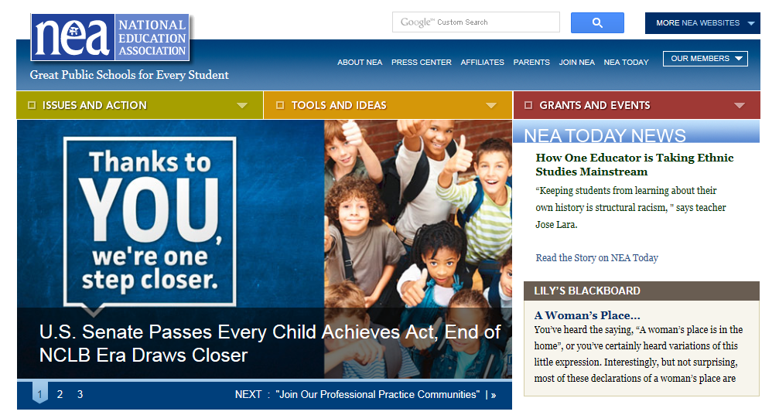

CEA website
www.cea.org
NEA website
www.nea.org
CT State Department of Education
www.sde.ct.gov

Slide 17
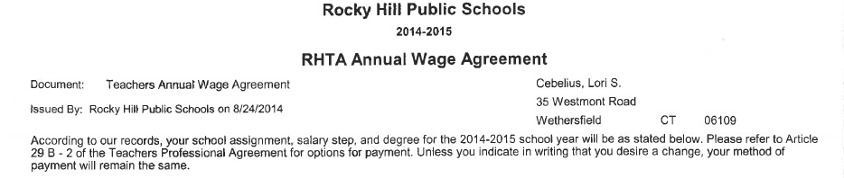
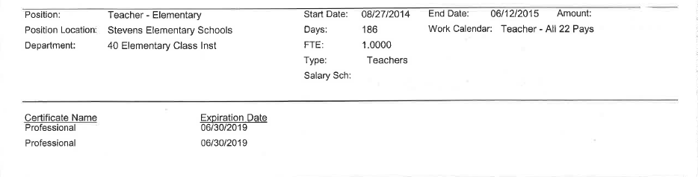
CERTIFICATION
It is YOUR RESPONSIBILITY to know when your CERTIFICATION EXPIRES.
This information can be found at the bottom of your RHTA Annual Wage Agreement

Slide 18
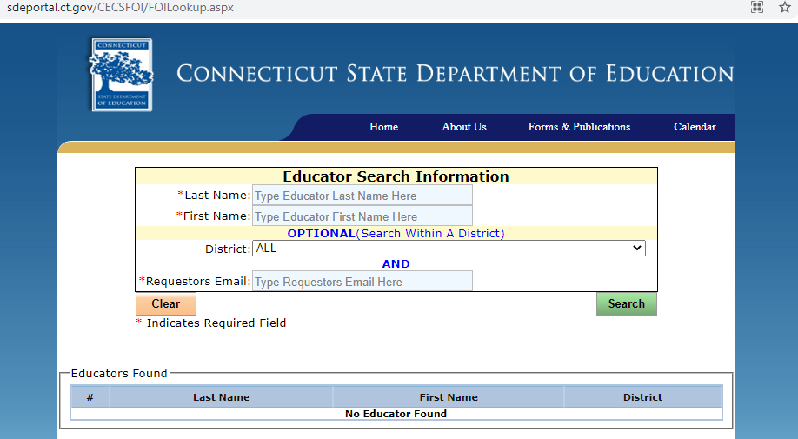
Look up your certification online!
http://sdeportal.ct.gov/CECSFOI/FOILookup.aspx

Slide 19
Weingarten Rights Your Weingarten Rights
Every member of RHTA (or any union for that matter) has the right to have union representation at certain kinds of meetings. The Weingarten rights are named after the Supreme Court case bearing that name that was decided in 1975.
In a nutshell, you can ask for and expect union representation (either a building rep or an officer of the union) under the following conditions:
The interview/meeting is requested by your supervisor/administration.
You reasonably believe that the meeting is disciplinary in nature or could jeopardize your job security.
You, the teacher, have requested union representation.
The employer MAY NOT:
Require the Association representative to remain silent throughout the meeting.
Require the Association representative to remain silent until after the employer has finished questioning and eliciting answers from the teacher.
Require the representative to channel his/her questions through the teacher.
Weingarten Rights do not apply to:
Normal, “run of the mill” meetings
Meetings in which the teacher is simply being given a letter or told a consequence after the initial interview has taken place and decision has been reached. Sometimes reps attend these meetings but their presence is not guaranteed under Weingarten.

Slide 20

NEGOTIATIONS~
Fall of 2019 we negotiated a 4 year contract
July 1, 2020- June 30, 2024
Matt DeBacco
Adele Gali
Doug Russell
Heidi Kokoska
Karla Harding
Michelle Bartha
Moser?
Stevens ?
West Hill?
We will begin negotiations next summer. We anticipate sending out a survey this spring to gain a greater understanding of what is most important to you in our contract.
Stipends for academic activities

Slide 21

A minute to recognize some teacher milestones!

Slide 22

Brenna Conrad
Jordan Szczygiel
RHHS
5
years
GMS
Tim Donovan
MOSER
Joe Couture
Meghan Hickey
Julia Zagaja
STEVENS
Kaitlyn Synott
WEST HILL
Leah Gillooly
Gabrielle Sobilo
Paolo Zocco

Slide 23

10
Sarah Rojas
Geraldine Tangney
Bryan Wziontko
RHHS
years
GMS
Karen Graca
Liz Selig
MOSER
Lisa Patnoe
Katie DeLoureiro
WEST HILL
Kate Ancona
Robin Otis

Slide 24

Kelly Bobair
Heather Morgan
Cynthia Latina
Catherine Mader
RHHS
15
years
GMS
Laura Litke
Michelle Walerysiak
MOSER
Kristen Baltazar
Alexis Gottsegen-Brown
Carissa Lastrina
STEVENS
Karen Rissinger
WEST HILL
Linda Aiello

Slide 25

RHHS
Robin Burnham
Linda Ceruzzi
Dave Fortier
Kathleen Lessard
Eileen Schnyder
20
years
GMS
Marissa Violette
MOSER
Tina DeJackome
WEST HILL
Deb Lynch
Jenn Paragone

Slide 26

Kim Antol
Adele Gali
25
RHHS
years
STEVENS
Andrea Hillman
Kim Teitelman

Slide 27

30
RHHS
John Reiser
years
GMS
Tyrrell White
Cari Willson
STEVENS
Amy Churyk

Slide 28

35
RHHS
Don Brown
years

Slide 29

40
35+
GMS
Jeannie Robertson
years

Slide 30
RHTA MEETINGS
4TH Wednesday of every month at GMS
library media center 3:45
September 28th
January 25th
October 26th
February 22nd
November –no meeting
March 22nd
December –no meeting
April 26th
May 24th ~ Elections
Schedules will also be posted in your building

Slide 31



RHTA Social
Friday September 9th
Thank you Adele!
watch your mailbox for more information

Slide 32

HAVE A GREAT YEAR!
We’re here if you need us!

Slide 33
Weingarten Rights Your Weingarten Rights
Every member of RHTA (or any union for that matter) has the right to have union representation at certain kinds of meetings. The Weingarten rights are named after the Supreme Court case bearing that name that was decided in 1975.
In a nutshell, you can ask for and expect union representation (either a building rep or an officer of the union) under the following conditions:
The interview/meeting is requested by your supervisor/administration.
You reasonably believe that the meeting is disciplinary in nature or could jeopardize your job security.
You, the teacher, have requested union representation.
The employer MAY NOT:
Require the Association representative to remain silent throughout the meeting.
Require the Association representative to remain silent until after the employer has finished questioning and eliciting answers from the teacher.
Require the representative to channel his/her questions through the teacher.
Weingarten Rights do not apply to:
Normal, “run of the mill” meetings
Meetings in which the teacher is simply being given a letter or told a consequence after the initial interview has taken place and decision has been reached. Sometimes reps attend these meetings but their presence is not guaranteed under Weingarten.

Slide 34
CONTINUE TO THE NEXT SLIDE FOR MORE INFORMATION!

Slide 35
PAYSTUB ON THE WEB PORTAL
2 ways to get there…..
Employee self service portal for infinite visions.
The link is https://ivisions.tylertech.com/RockyHillESS
Email from JoAnn Turcotte or Tsampica Mal if you need help.
OR
Sign in through school website, rockyhillps.com

Slide 36
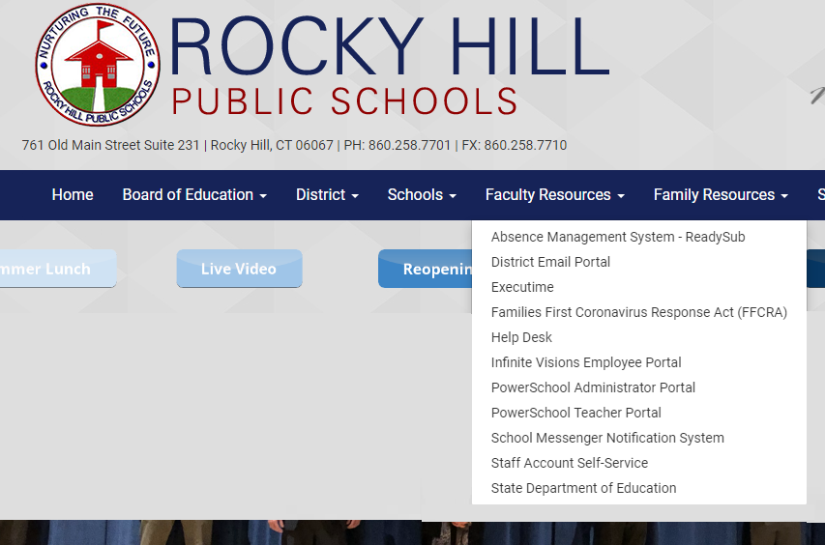
PAYSTUB ON THE WEB PORTAL
www.rockyhillps.com
Faculty Resources
Infinite Visions Employee Portal

Slide 37
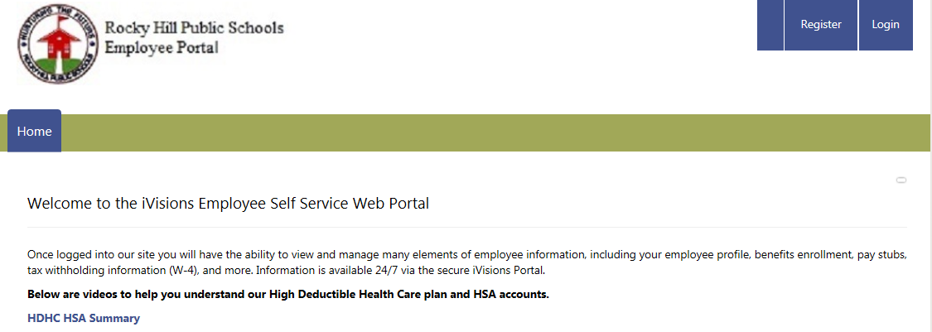
Log in just as you would the computer in your classroom. If this is your first time logging in use “Changeme15!” as your initial password. You will be prompted to change password. Do not register as an employee, you have already been registered.
PAYSTUB ON THE WEB PORTAL CONTINUED…
Log in

Slide 38
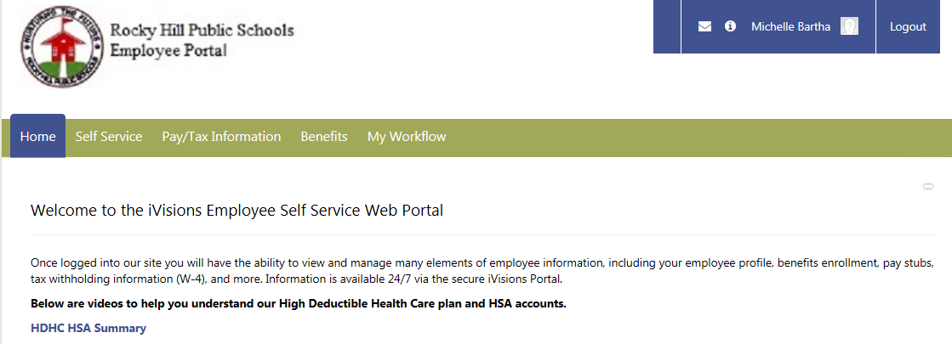
PAYSTUB ON THE WEB PORTAL CONTINUED…

Slide 39
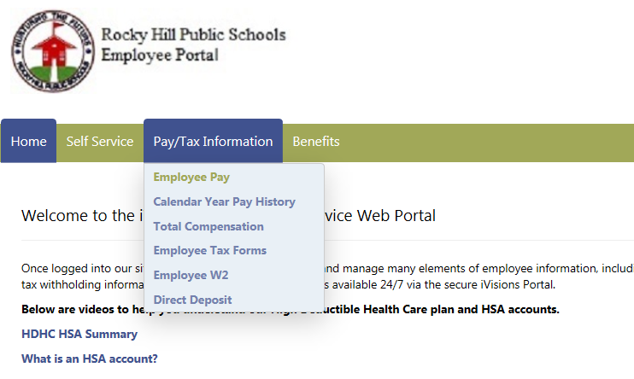
This is where you will be able to keep track of TRB, insurance, and 403B contributions etc

Slide 40
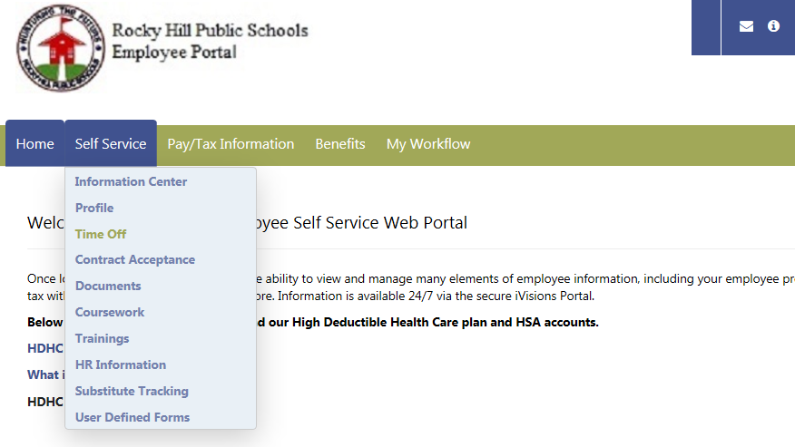
This is where you will be able to keep track sick days and discretionary days

Slide 41
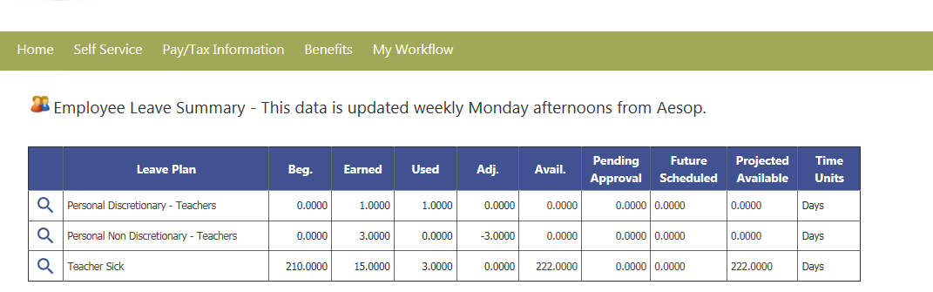
Be sure to monitor your sick days, insurance contributions and the like.

Slide 42
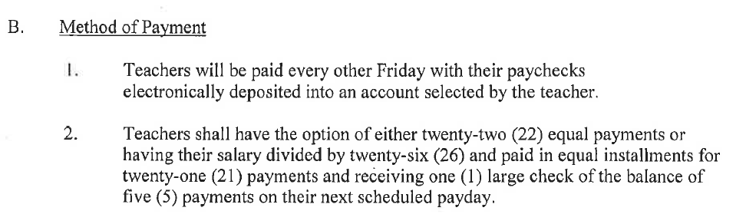
Article 30 B page 22 your last paycheck this year will be June 9th regardless of the last day of school.
This information can be found on the district website under
staff resources
forms and documents
payroll forms

Slide 43
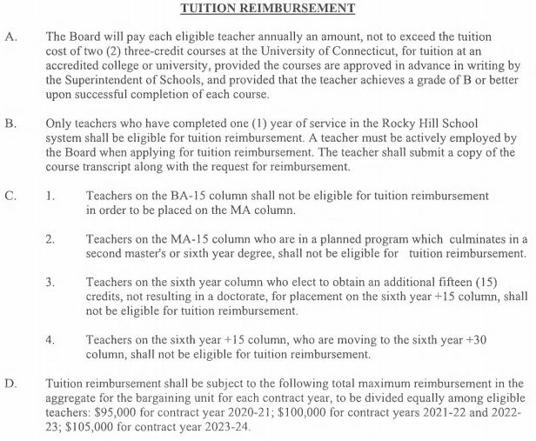
Tuition reimbursement
Eligible once you have 1 year of service in Rocky Hill
Equivalent to the cost of a 3 credit UConn graduate course
Allowed TWO courses per year
Remember to get it approved
$100,000 cap
Article 28 A, B & D
page 19

Slide 44
Tuition reimbursement
Eligible once you have 1 year of service in Rocky Hill
$100,000 Cap per year (2022-2023)
1 payout for the year; end of June, separate check
Procedure & Documents can be found on the website
Send in proof of payment & grades as you get them.
Unofficial transcript is ok; Official transcript only needed when you finish program and move degree columns
May 30th deadline for paperwork. Payment in June.
Classes this summer will be reimbursed June 2023

Slide 45
Tuition reimbursement
Eligible once you have 1 year of service in Rocky Hill
$100,000 will be split among those taking classes, up to full reimbursement for two UConn Graduate classes.
Essentially the time frame is for classes is mid-May to April; paid the following June.
Unofficial transcript is ok; Official transcript only needed when you finish program and move degree columns
May 30th deadline for paperwork. Payment in June.
Any questions do not hesitate to call Christine Flynn at the BOE 860-258-7720

Slide 46
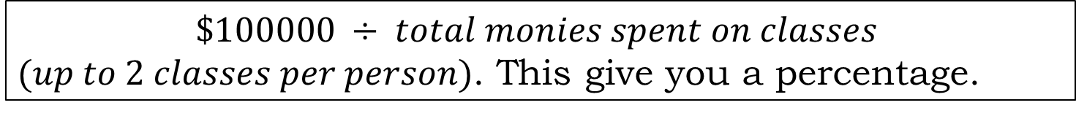
Tuition reimbursement
Eligible once you have 1 year of service in Rocky Hill
How reimbursement is calculated
$$\$100000 ÷ total monies spent on classes$$
$(up to 2 classes per person)$. This give you a percentage.
That percentage is applied to the amount you paid out of pocket. This is the amount of reimbursement you receive.
This can vary year to year depending on how many people are taking classes and seeking reimbursement.
Any questions do not hesitate to call Christine Flynn at the BOE 860-258-7720

